Slide 1

Data Visualization using Matplotlib

Slide 2
Data visualization using matplotlib
Plots in Matplotlib have a hierarchical structure that nests Python objects to create a tree-like structure. Each plot is encapsulated in a Figure object. This Figure is the top-level container of the visualization. It can have multiple axes, which are basically individual plots inside this top-level container

Slide 3
A figure contains at least one axes object
Figure
Axes 1
Axes 2
...
Axes N
Furthermore, we again find Python objects that control axes, tick marks, legends, titles, text boxes, the grid, and many other objects. All of these objects can be customized

Slide 4
Components of plot
The two main components of plot are as follows:
Figure The Figure is an outermost container that allows you to draw multiple plots within it. It not only holds the Axes object but also has the ability to configure the Title.
Axes The axes is an actual plot, or subplot, depending on whether you want to plot single or multiple visualizations. Its sub-objects include the x-axis, y-axis, spines, and legends.

Slide 5
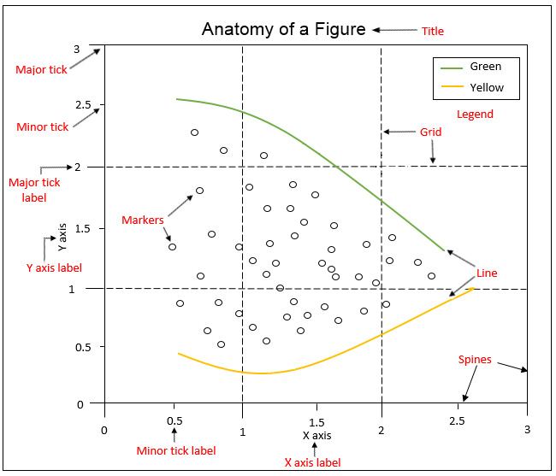
Anatomy of a matplotlib figure

Slide 6
Deeper look into the anatomy
Taking a deeper look into the anatomy of a Figure object, we can observe the following components:
Spines: Lines connecting the axis tick marks
Title: Text label of the whole Figure object
Legend: Describes the content of the plot
Grid: Vertical and horizontal lines used as an extension of the tick marks
X/Y axis label: Text labels for the X and Y axes below the spines

Slide 7
Deeper look into the anatomy
Minor tick: Small value indicators between the major tick marks
Minor tick label: Text label that will be displayed at the minor ticks
Major tick: Major value indicators on the spines
Major tick label: Text label that will be displayed at the major ticks
Line: Plotting type that connects data points with a line
Markers: Plotting type that plots every data point with a defined marker

Slide 8
Deep Dive Into Matplotlib

Slide 9
PyPlot
pyplot contains a simpler interface for creating visualizations that allow the users to plot the data without explicitly configuring the Figure and Axes themselves. They are automatically configured to achieve the desired output. It is handy to use the alias plt to reference the imported submodule, as follows
import matplotlib.pyplot as plt

Slide 10
Common operations using PyPlot
Some of the common operations that are performed while using pyplot are:
Creating Figures
Closing Figures
Format Strings
Plotting
Plotting using Pandas Dataframes
Ticks
Displaying Figures
Saving Figures

Slide 11
Creating Figures

Slide 12
Creating figures
You can use plt.figure() to create a new Figure. This function returns a Figure instance, but it is also passed to the backend. Every Figure-related command that follows is applied to the current Figure and does not need to know the Figure instance.

Slide 13
Creating figures
By default, the Figure has a width of 6.4 inches and a height of 4.8 inches with a dpi (dots per inch) of 100. To change the default values of the Figure, we can use the parameters figsize and dpi.
The following code snippet shows how we can manipulate a Figure:
plt.figure(figsize=(10, 5))#To change the width and the height
plt.figure(dpi=300) #To change the dpi

Slide 14
Closing Figures

Slide 15
Closing figures
Figures that are no longer used should be closed by explicitly calling plt.close(), which also cleans up memory efficiently.
If nothing is specified, the plt.close() command will close the current Figure. To close a specific Figure, you can either provide a reference to a Figure instance or provide the Figure number. To find the number of a Figure object, we can make use of the number attribute, as follows:
plt.gcf().number

Slide 16
Closing figures
The plt.close('all') command is used to close all active Figures. The following example shows how a Figure can be created and closed:
plt.figure(num=10) #Create Figure with Figure number 10
plt.close(10) #Close Figure with Figure number 10
Note: For a small Python script that only creates a visualization, explicitly closing a Figure isn't required, since the memory will be cleaned in any case once the program terminates. But if you create lots of Figures, it might make sense to close Figures in between so as to save memory

Slide 17
Format Strings

Slide 18
Format strings
Before we actually plot something, let's quickly discuss format strings. They are a neat way to specify colors, marker types, and line styles. A format string is specified as [color][marker][line], where each item is optional. If the color argument is the only argument of the format string, you can use matplotlib.colors

Slide 19
Format strings
Matplotlib recognizes the following formats, among others:
RGB or RGBA float tuples (for example, (0.2, 0.4, 0.3) or (0.2, 0.4, 0.3, 0.5))
RGB or RGBA hex strings (for example, '#0F0F0F' or '#0F0F0F0F')

Slide 20
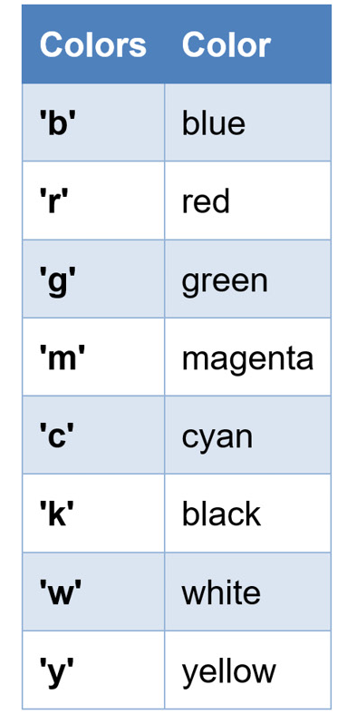
Format strings - color
The following table is an example of how a color can be represented in one particular format

Slide 21
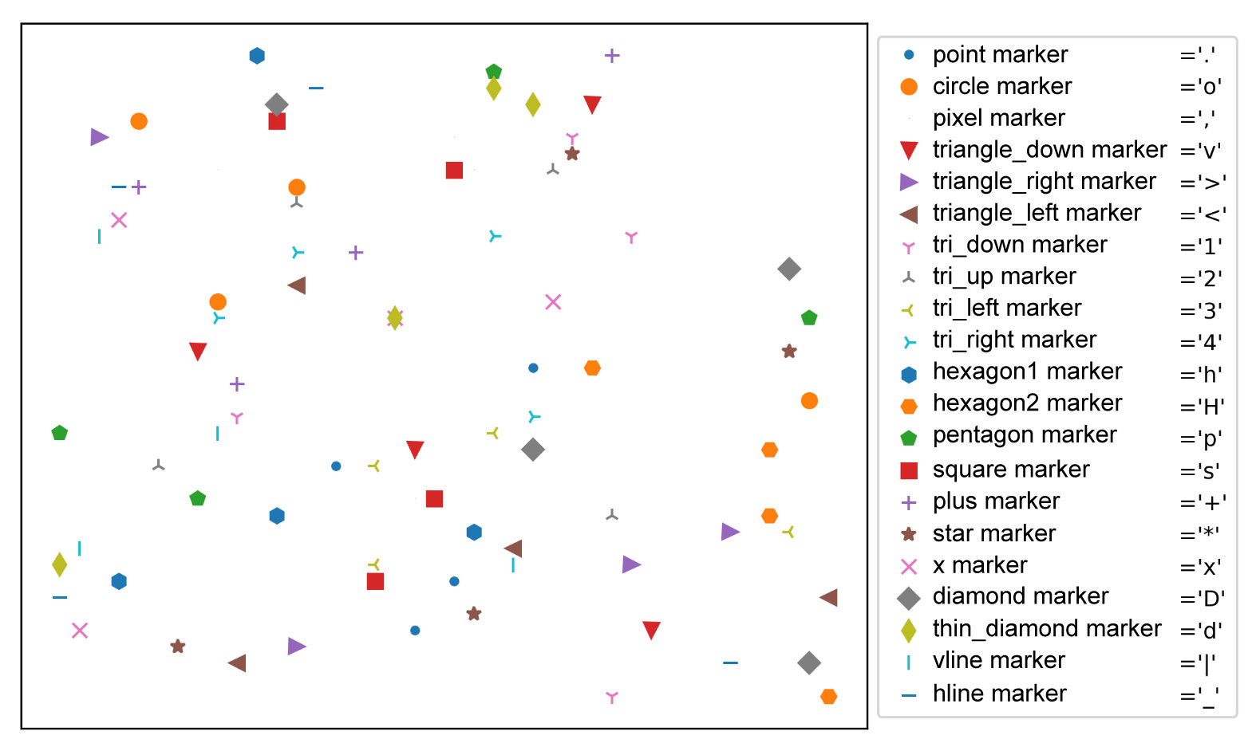
Format strings - color
All the available marker options are illustrated in the following figure:

Slide 22
Format strings - markers
All the available line styles are illustrated in the following diagram. In general, solid lines should be used. We recommend restricting the use of dashed and dotted lines to either visualize some bounds/targets/goals or to depict uncertainty, for example, in a forecast:

Slide 23
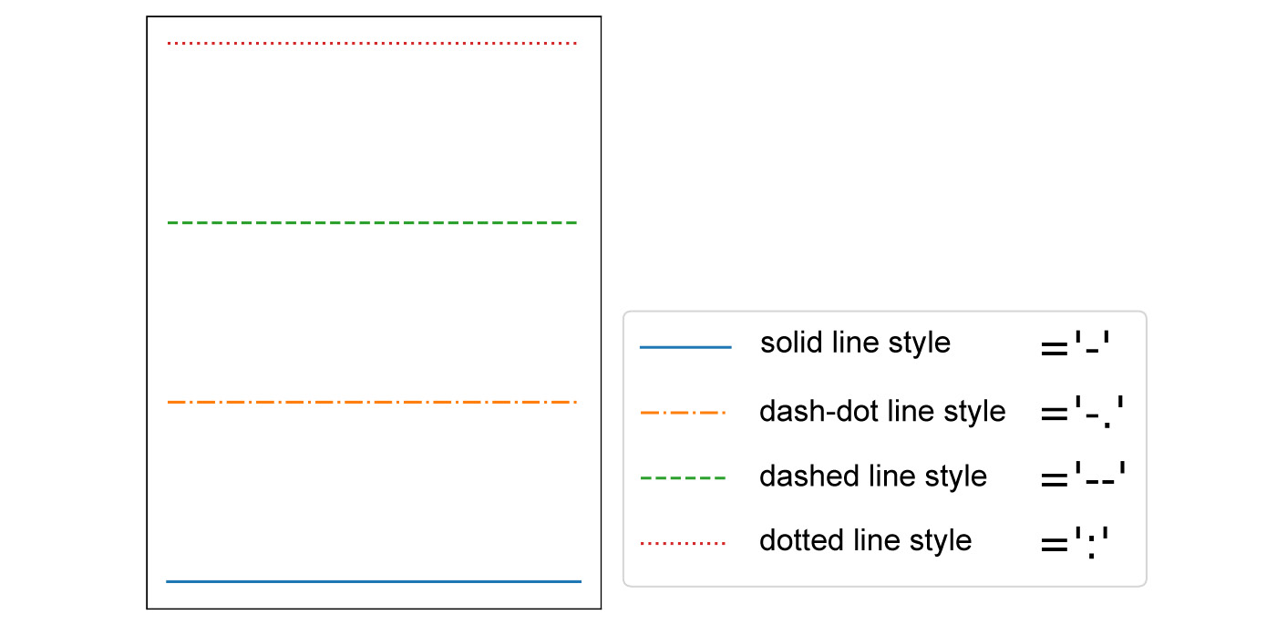
Format strings - markers
To conclude, format strings are a handy way to quickly customize colors, marker types, and line styles. It is also possible to use arguments, such as color, marker, and linestyle.

Slide 24
Plotting

Slide 25
Plotting
With plt.plot([x], y, [fmt]), you can plot data points as lines and/or markers. The function returns a list of Line2D objects representing the plotted data. By default, if you do not provide a format string (fmt), the data points will be connected with straight, solid lines.

Slide 26
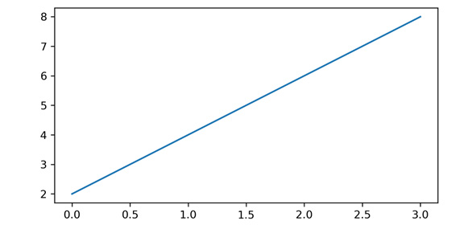
Plotting data as line
plt.plot([0, 1, 2, 3], [2, 4, 6, 8]) produces a plot, as shown in the following diagram. Since x is optional and the default values are [0, …, N-1], plt.plot([2, 4, 6, 8]) results in the same plot:
Plotting data as a line

Slide 27
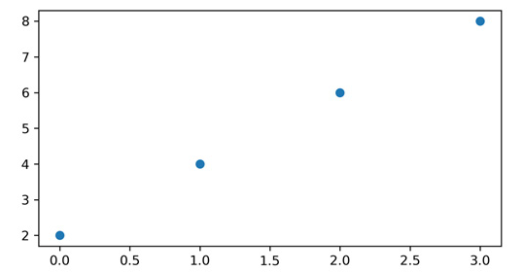
Plotting data points with markers
If you want to plot markers instead of lines, you can just specify a format string with any marker type. For example, plt.plot([0, 1, 2, 3], [2, 4, 6, 8], 'o') displays data points as circles, as shown in the following diagram:
Plotting data points with markers (circles)

Slide 28
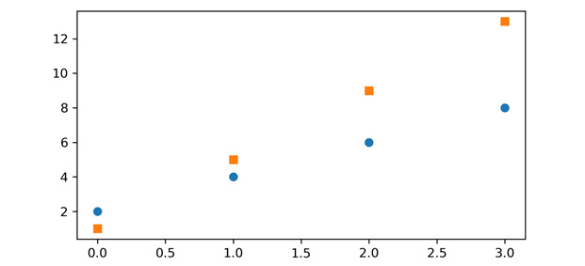
Plotting data points with multiple markers
To plot multiple data pairs, the syntax plt.plot([x], y, [fmt], [x], y2, [fmt2], …) can be used. plt.plot([2, 4, 6, 8], 'o', [1, 5, 9, 13], 's') results in the following diagram. Similarly, you can use plt.plot multiple times, since we are working on the same Figure and Axes:
Plotting data points with multiple markers

Slide 29
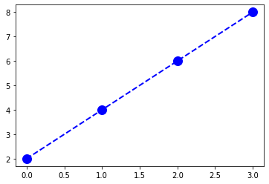
Plotting
Any Line2D properties can be used instead of format strings to further customize the plot. For example, the following code snippet shows how we can additionally specify the linewidth and markersize arguments
plt.plot([2, 4, 6, 8], color='blue', marker='o', linestyle='dashed', linewidth=2, markersize=12)

Slide 30
Plotting using Pandas DataFrames

Slide 31
Plotting using pandas dataframe
It is pretty straightforward to use pandas.DataFrame as a data source. Instead of providing x and y values, you can provide the pandas.DataFrame in the data parameter and give keys for x and y, as follows:
plt.plot('x_key', 'y_key', data=df)
If your data is already a pandas DataFrame, this is the preferred way

Slide 32
Ticks

Slide 33
Ticks
Tick locations and labels can be set manually if Matplotlib's default isn't sufficient. Considering the previous plot, it might be preferable to only have ticks at multiples of ones at the x-axis. One way to accomplish this is to use plt.xticks() and plt.yticks() to either get or set the ticks manually.
plt.xticks(ticks, [labels], [**kwargs]) sets the current tick locations and labels of the x-axis

Slide 34
Ticks - parameters
ticks: List of tick locations; if an empty list is passed, ticks will be disabled.
labels (optional): You can optionally pass a list of labels for the specified locations.
**kwargs (optional): matplotlib.text.Text() properties can be used to customize the appearance of the tick labels. A quite useful property is rotation; this allows you to rotate the tick labels to use space more efficiently.

Slide 35
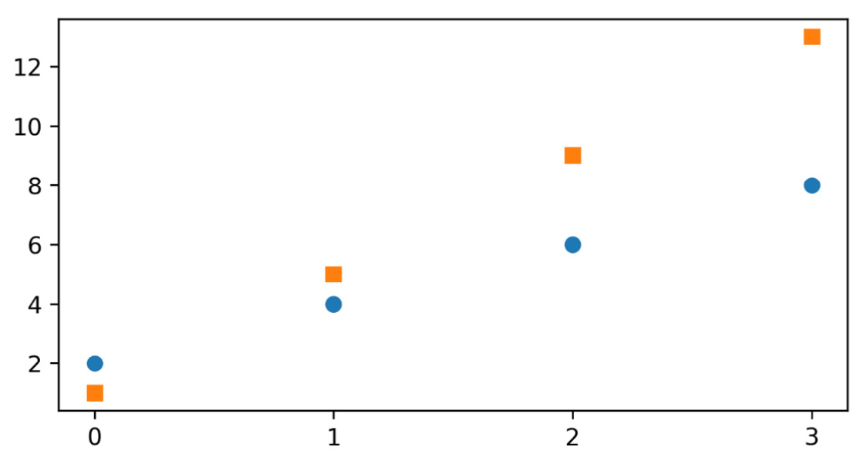
Ticks - Example
plt.figure(figsize=(6, 3))
plt.plot([2, 4, 6, 8], 'o', [1, 5, 9, 13], 's')
plt.xticks(ticks=np.arange(4))
This will result in the following plot:
Plot with custom ticks

Slide 36
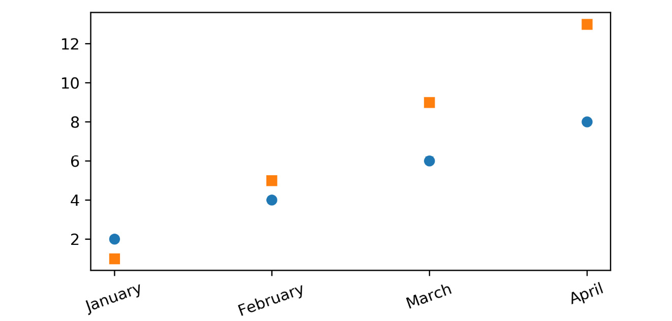
Ticks - Example
It's also possible to specify tick labels, as follows:
plt.figure(figsize=(6, 3))
plt.plot([2, 4, 6, 8], 'o', [1, 5, 9, 13], 's')
plt.xticks(ticks=np.arange(4), labels=['January', 'February', 'March', 'April'], rotation=20)
Plot with custom tick labels

Slide 37
Ticks - Note
If you want to do even more sophisticated things with ticks, you should look into tick locators and formatters. For example, ax.xaxis.set_major_locator(plt.NullLocator()) would remove the major ticks of the x-axis, and ax.xaxis.set_major_formatter(plt.NullFormatter()) would remove the major tick labels, but not the tick locations of the x-axis

Slide 38
Displaying Figures

Slide 39
Displaying figures
plt.show() is used to display a Figure or multiple Figures. To display Figures within a Jupyter Notebook, simply set the %matplotlib inline command at the beginning of the code.
If you forget to use plt.show(), the plot won't show up.

Slide 40
Saving Figures

Slide 41
Saving figures
The plt.savefig(fname) saves the current Figure. There are some useful optional parameters you can specify, such as dpi, format, or transparent.

Slide 42
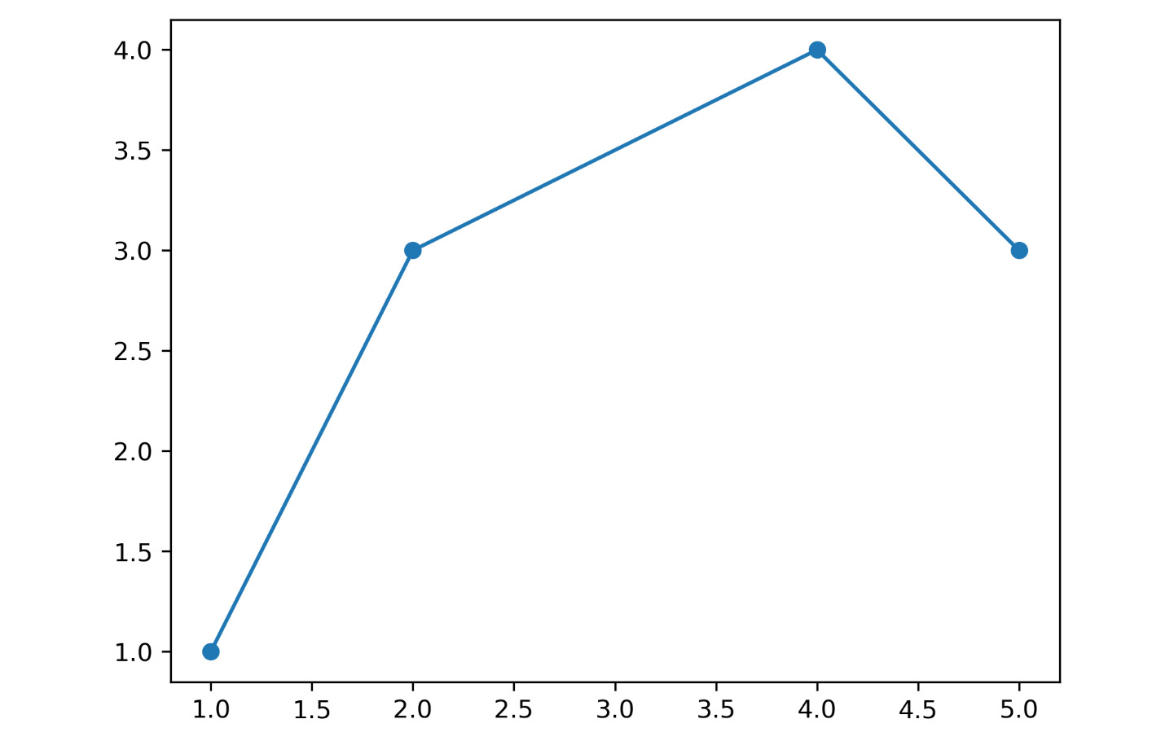
Saving figures
The following code snippet gives an example of how you can save a Figure:
plt.figure()
plt.plot([1, 2, 4, 5], [1, 3, 4, 3], '-o')
plt.savefig('lineplot.png', dpi=300, bbox_inches='tight')
#bbox_inches='tight' removes the outer white margins
Output:
Saved Figure

Slide 43
Note
All of the functions we discuss, except for the legend, create and return a matplotlib.text.Text() instance. We are mentioning it here so that you know that all of the properties discussed can be used for the other functions as well

Slide 44
Labels

Slide 45
Labels
Matplotlib provides a few label functions that we can use for setting labels to the x- and y-axes. The plt.xlabel() and plt.ylabel() functions are used to set the label for the current axes. The set_xlabel() and set_ylabel() functions are used to set the label for the specified axes
ax.set_xlabel('X Label')
ax.set_ylabel('Y Label')
You should (always) add labels to make a visualization more self-explanatory.

Slide 46
Titles

Slide 47
Titles
A title describes a particular chart/graph. The titles are placed above the axes in the center, left edge, or right edge. There are two options for titles – you can either set the Figure title or the title of an Axes. The suptitle() function sets the title for the current and specified Figure. The title() function helps in setting the title for the current and specified axes
fig = plt.figure()
fig.suptitle('Suptitle', fontsize=10, fontweight='bold')
This creates a bold Figure title with a text subtitle and a font size of 10

Slide 48
Titles
plt.title('Title', fontsize=16)
The plt.title function will add a title to the Figure with text as Title and font size of 16 in this case.

Slide 49
Text

Slide 50
Text
There are two options for text – you can either add text to a Figure or text to an Axes. The figtext(x, y, text) and text(x, y, text) functions add text at locations x or y for a Figure
ax.text(4, 6, 'Text in Data Coords', bbox={'facecolor': 'yellow', 'alpha':0.5, 'pad':10})
This creates a yellow text box with the text Text in Data Coords.
Text can be used to provide additional textual information to a visualization. To annotate something, Matplotlib offers annotations

Slide 51
Annotations

Slide 52
Annotations
Compared to text that is placed at an arbitrary position on the Axes, annotations are used to annotate some features of the plot. In annotations, there are two locations to consider: the annotated location, xy, and the location of the annotation, text xytext. It is useful to specify the parameter arrowprops, which results in an arrow pointing to the annotated location

Slide 53
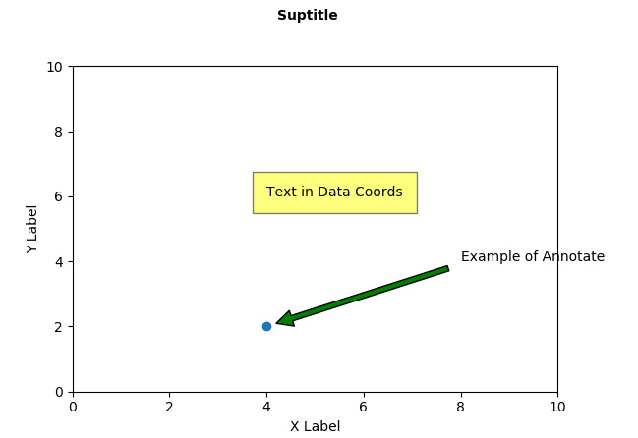
Annotations - Example
ax.annotate('Example of Annotate', xy=(4,2), xytext=(8,4), arrowprops=dict(facecolor='green', shrink=0.05))
This creates a green arrow pointing to the data coordinates (4, 2) with the text Example of Annotate at data coordinates (8, 4):
Implementation of text commands

Slide 54
Legends

Slide 55
Legends
Legend describes the content of the plot. To add a legend to your Axes, we have to specify the label parameter at the time of plot creation. Calling plt.legend() for the current Axes or Axes.legend() for a specific Axes will add the legend. The loc parameter specifies the location of the legend

Slide 56
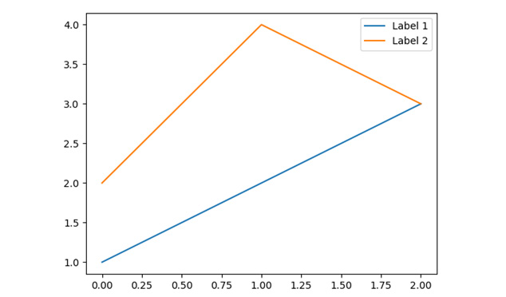
Legends - Example
plt.plot([1, 2, 3], label='Label 1')
plt.plot([2, 4, 3], label='Label 2')
plt.legend()
Legend Example

Slide 57
Note
Labels, titles, text, annotations, and a legend are great ways to add textual information to visualization and therefore make it more understandable and self-explanatory. But don't overdo it. Too much text can be overwhelming.

Slide 58
Bar Chart

Slide 59
Bar chart
The plt.bar(x, height, [width]) creates a vertical bar plot. For horizontal bars, use the plt.barh() function
Important Parameters:
x: Specifies the x coordinates of the bars
height: Specifies the height of the bars
width (optional): Specifies the width of all bars; the default is 0.8

Slide 60
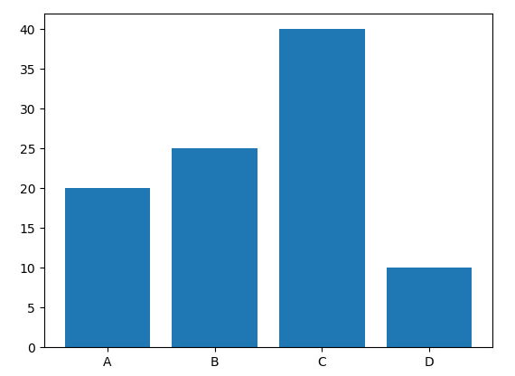
Bar chart - Example
plt.bar(['A', 'B', 'C', 'D'], [20, 25, 40, 10])
A simple bar chart

Slide 61
Barchart
If you want to have subcategories, you have to use the plt.bar() function multiple times with shifted x-coordinates. (We will see an example). The arange() function is a method in the NumPy package that returns evenly spaced values within a given interval. The gca() function helps in getting the instance of current axes on any current Figure. The set_xticklabels() function is used to set the x-tick labels with the list of given string labels

Slide 62
Bar chart - Example - Code
labels = ['A', 'B', 'C', 'D']
x = np.arange(len(labels))
width = 0.4
plt.bar(x – width / 2, [20, 25, 40, 10], width=width)
plt.bar(x – width / 2, [30, 15, 30, 20], width=width)
# Ticks and tick labels must be set manually
plt.ticks(x)
ax = plt.gca()
ax.set_xticklabels(labels)

Slide 63
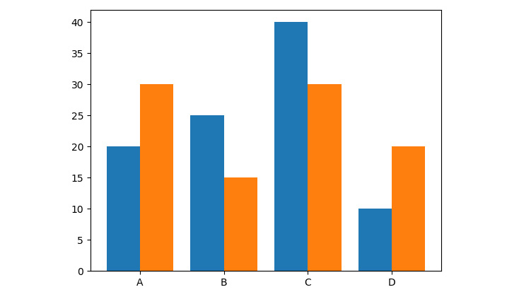
Bar chart - Example
Output:
Bar chart with subcategories

Slide 64
Creating a bar plot for movie comparison
We will create visually appealing bar plots. We will use a bar plot to compare movie scores. You are given five movies with scores from Rotten Tomatoes. The Tomatometer is the percentage of approved Tomatometer critics who have given a positive review for the movie. The Audience Score is the percentage of users who have given a score of 3.5 or higher out of 5. Compare these two scores among the five movies.

Slide 65
Creating a bar plot for movie comparison - Steps
The following are the steps to perform:
Import the necessary modules and enable plotting within a Jupyter Notebook.
Use pandas to read the ‘movie_scores.csv' data
Use Matplotlib to create a visually appealing bar plot comparing the two scores for all five movies.

Slide 66
Creating a bar plot for movie comparison - Steps
Use the movie titles as labels for the x-axis. Use percentages at intervals of 20 for the y-axis and minor ticks at intervals of 5. Add a legend and a suitable title to the plot.
Use functions that are required to explicitly specify the axes. To get the reference to the current axes, use ax = plt.gca(). To add minor y-ticks, use Axes.set_yticks([ticks], minor=True). To add a horizontal grid for major ticks, use Axes.yaxis.grid(which='major'), and to add a dashed horizontal grid for minor ticks, use Axes.yaxis.grid(which='minor', linestyle='--').

Slide 67
Creating a bar plot for movie comparison - Code
# Create figure
plt.figure(figsize=(10, 5), dpi=300)
# Create bar plot
pos = np.arange(len(movie_scores['MovieTitle']))
width = 0.3
plt.bar(pos - width / 2, movie_scores['Tomatometer'], width, label='Tomatometer')
plt.bar(pos + width / 2, movie_scores['AudienceScore'], width, label='Audience Score')
# Specify ticks
plt.xticks(pos, rotation=10)
plt.yticks(np.arange(0, 101, 20))
# Get current Axes for setting tick labels and horizontal grid
ax = plt.gca()

Slide 68
Creating a bar plot for movie comparison - Code (contd)
# Set tick labels
ax.set_xticklabels(movie_scores['MovieTitle'])
ax.set_yticklabels(['0%', '20%', '40%', '60%', '80%', '100%'])
# Add minor ticks for y-axis in the interval of 5
ax.set_yticks(np.arange(0, 100, 5), minor=True)
# Add major horizontal grid with solid lines
ax.yaxis.grid(which='major')
# Add minor horizontal grid with dashed lines
ax.yaxis.grid(which='minor', linestyle='--')
# Add title
plt.title('Movie comparison')
# Add legend
plt.legend()
# Show plot
plt.show()

Slide 69
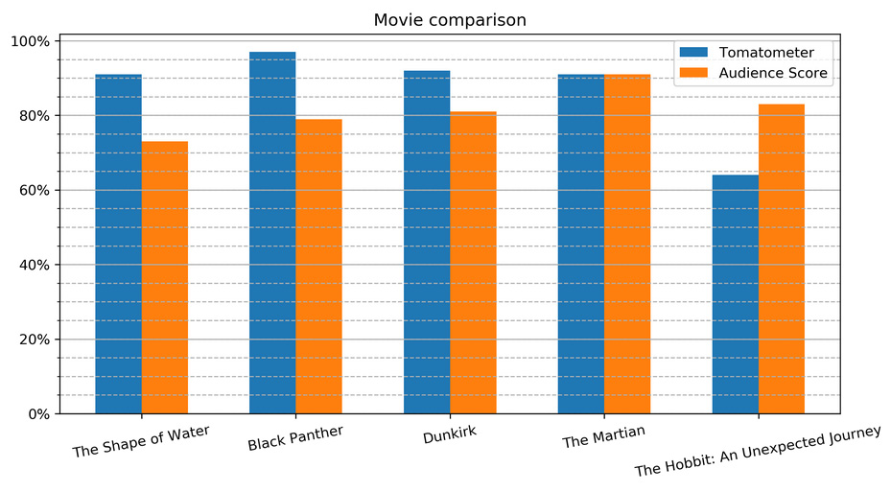
Creating a bar plot for movie comparison - Output
Bar plot comparing scores of five movies

Slide 70
Pie Chart

Slide 71
Pie chart
The plt.pie(x, [explode], [labels], [autopct]) function creates a pie chart
Important Parameters:
x: Specifies the slice sizes.
explode (optional): Specifies the fraction of the radius offset for each slice. The explode-array must have the same length as the x-array.
labels (optional): Specifies the labels for each slice.
autopct (optional): Shows percentages inside the slices according to the specified format string. Example: '%1.1f%%'

Slide 72
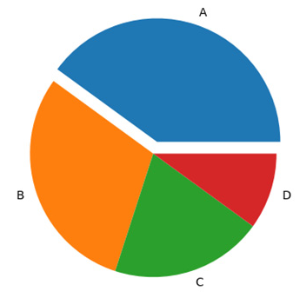
Pie chart - Example
plt.pie([0.4, 0.3, 0.2, 0.1], explode=(0.1, 0, 0, 0), labels=['A', 'B', 'C', 'D'])
Basic pie chart

Slide 73
Creating a pie plot for water usage
We will use a pie chart to visualize water usage. There has been a shortage of water in your locality in the past few weeks. To understand the reason behind it, generate a visual representation of water usage using pie charts.

Slide 74
Creating a pie plot for water usage - Steps
The following are the steps to perform:
Import the necessary modules and enable plotting within a Jupyter Notebook.
Use pandas to read the ‘water_usage.csv’.
Use a pie chart to visualize water usage. Highlight one usage of your choice using the explode parameter. Show the percentages for each slice and add a title

Slide 75
Creating a pie plot for water usage - Code
# Create figure
plt.figure(figsize=(8, 8), dpi=300)
# Create pie plot
plt.pie('Percentage', explode=(0, 0, 0.1, 0, 0, 0), labels='Usage', data=data, autopct='%.0f%%')
# Add title
plt.title('Water usage')
# Show plot
plt.show()

Slide 76
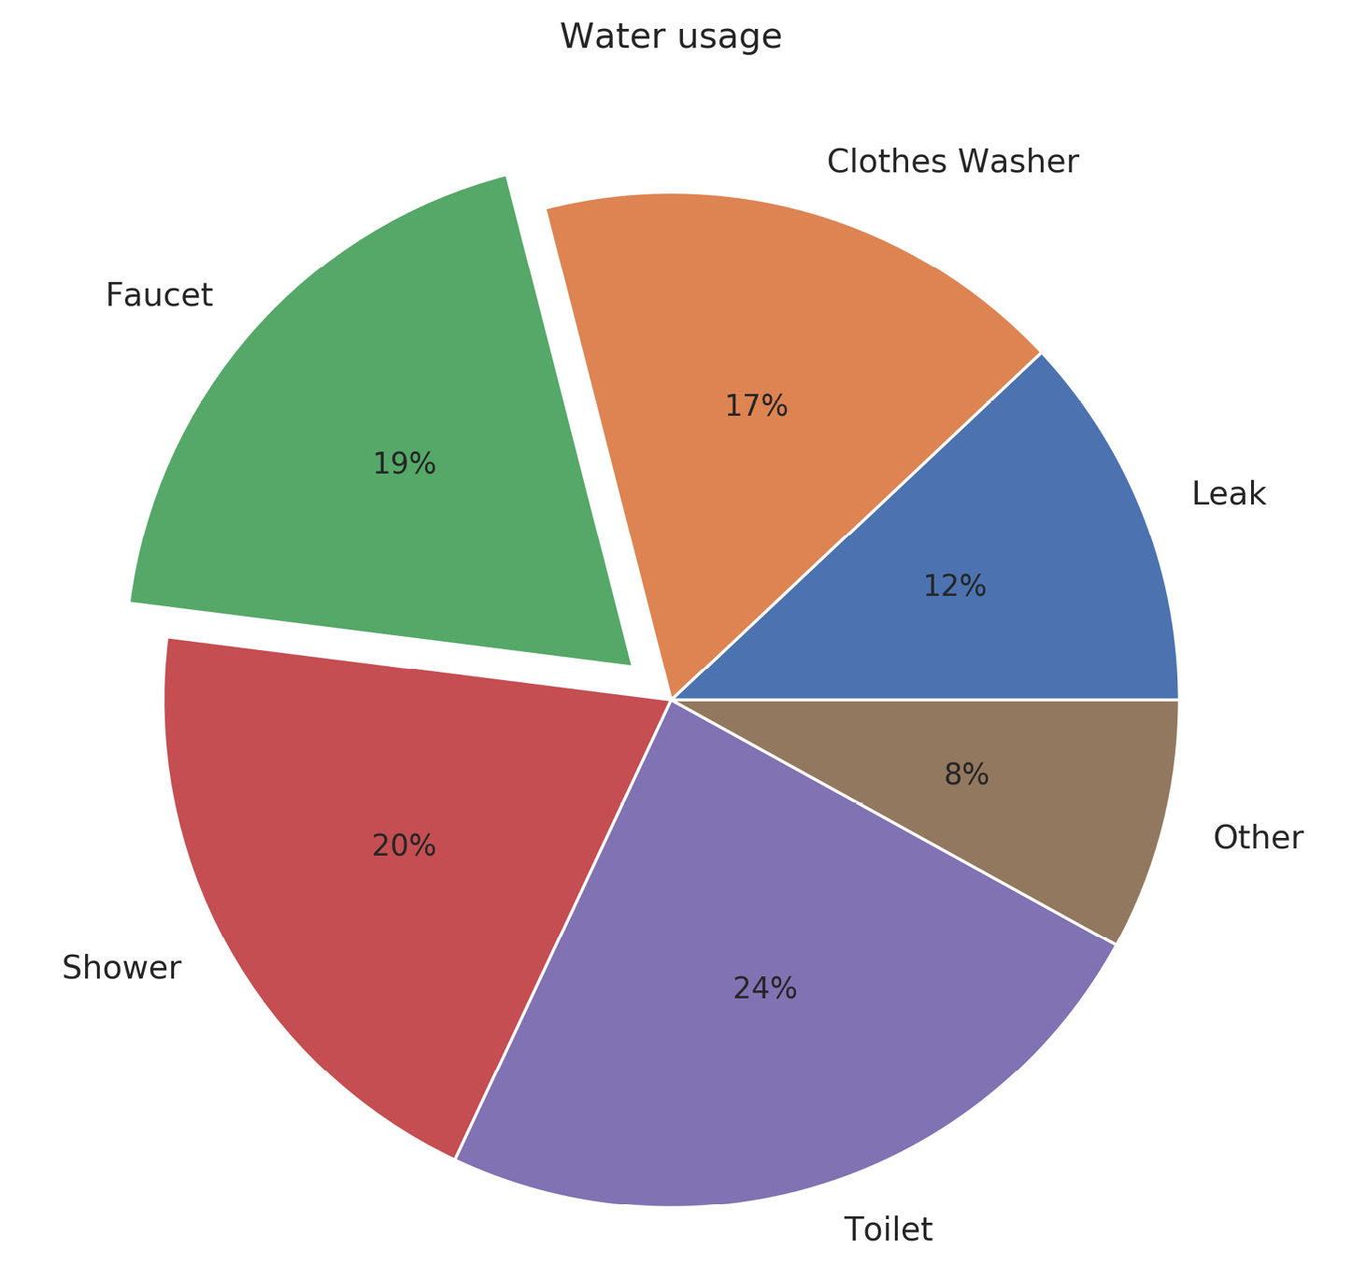
Creating a pie plot for water usage - Output
Pie chart for water usage

Slide 77
Stacked Bar Chart

Slide 78
Stacked bar chart
A stacked bar chart uses the same plt.bar function as bar charts. For each stacked bar, the plt.bar function must be called, and the bottom parameter must be specified, starting with the second stacked bar. This will become clear with the following example:

Slide 79
Stacked bar chart - Example - Code
# libraries
import numpy as np
import matplotlib.pyplot as plt
from matplotlib import rc
import pandas as pd
# y-axis in bold
rc('font', weight='bold')
# Values of each group
bars1 = [12, 28, 1, 8, 22]
bars2 = [28, 7, 16, 4, 10]
bars3 = [25, 3, 23, 25, 17]
# Heights of bars1 + bars2
bars = np.add(bars1, bars2).tolist()
# The position of the bars on the x-axis
r = [0,1,2,3,4]

Slide 80
Stacked bar chart - Example - Code (contd…)
# Names of group and bar width
names = ['A','B','C','D','E']
barWidth = 1
# Create brown bars
plt.bar(r, bars1, color='#7f6d5f', edgecolor='white', width=barWidth)
# Create green bars (middle), on top of the firs ones
plt.bar(r, bars2, bottom=bars1, color='#557f2d', edgecolor='white', width=barWidth)
# Create green bars (top)
plt.bar(r, bars3, bottom=bars, color='#2d7f5e', edgecolor='white', width=barWidth)
# Custom X axis
plt.xticks(r, names, fontweight='bold')
plt.xlabel("group")
# Show graphic
plt.show()

Slide 81
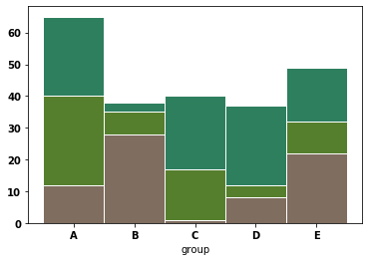
Stacked bar chart - Example - Output
A Stacked Bar Chart

Slide 82
Creating a stacked bar plot for restaurant performance
We will use a stacked bar plot to visualize the performance of a restaurant. Let's look at the following scenario: you are the owner of a restaurant and, due to a new law, you have to introduce a No Smoking Day. To make as few losses as possible, you want to visualize how many sales are made every day, categorized by smokers and non-smokers.
Use the dataset ‘tips’ which contains multiple entries of restaurant bills, and create a matrix where the elements contain the sum of the total bills for each day and smokers/non-smokers

Slide 83
Creating a stacked bar plot for restaurant performance
The following are the steps to perform:
Import all the necessary dependencies and load the tips dataset.
Use the given dataset and create a matrix where the elements contain the sum of the total bills for each day and split according to smokers/non-smokers.
Create a stacked bar plot, stacking the summed total bills separated according to smoker and non-smoker for each day.
Add a legend, labels, and a title. After executing the preceding steps.

Slide 84
Creating a stacked bar plot for restaurant performance - Code
# Create figure
plt.figure(figsize=(10, 5), dpi=300)
# Create stacked bar plot
plt.bar(days_range, totals[:, 0], label='Smoker')
plt.bar(days_range, totals[:, 1], bottom=totals[:, 0], label='Non-smoker')
# Add legend
plt.legend()

Slide 85
Creating a stacked bar plot for restaurant performance - Code (contd...)
# Add labels and title
plt.xticks(days_range)
ax = plt.gca()
ax.set_xticklabels(days)
ax.yaxis.grid()
plt.ylabel('Daily total sales in $')
plt.title('Restaurant performance')
# Show plot
plt.show()

Slide 86
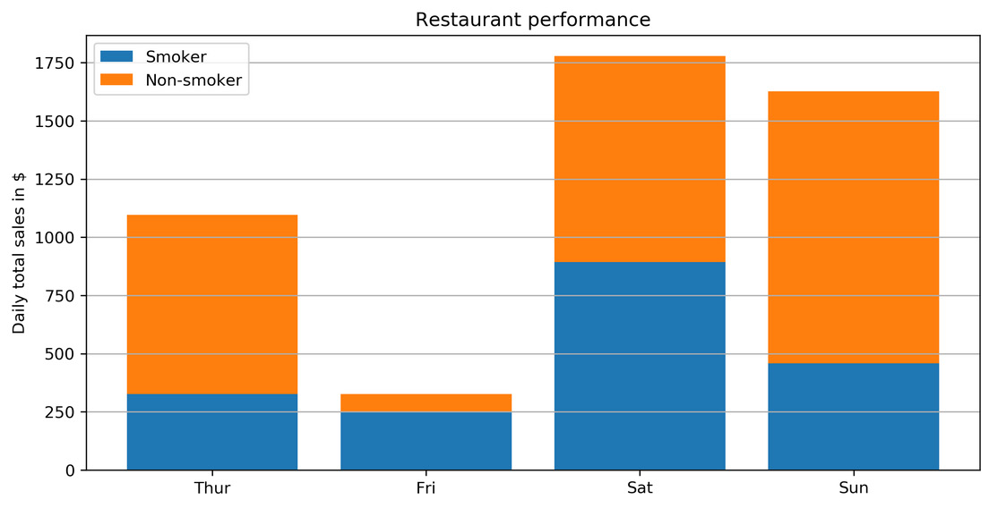
Creating a stacked bar plot for restaurant performance
Stacked bar chart showing the performance of a restaurant on different days

Slide 87
Stacked Area Chart

Slide 88
Stacked area chart
plt.stackplot(x, y) creates a stacked area plot
Important Parameters:
x: Specifies the x-values of the data series.
y: Specifies the y-values of the data series. For multiple series, either as a 2D array or any number of 1D arrays, call the following function: plt.stackplot(x, y1, y2, y3, …).
labels (optional): Specifies the labels as a list or tuple for each data series.

Slide 89
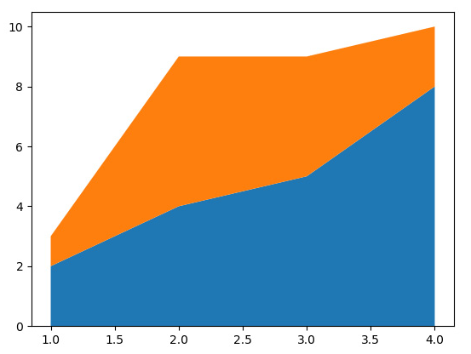
Stacked area chart - Example
plt.stackplot([1, 2, 3, 4], [2, 4, 5, 8], [1, 5, 4, 2])
A Stacked Area Chart

Slide 90
Creating a stacked area chart for smartphone sales unit
We will compare smartphone sales units using a stacked area chart. Let's look at the following scenario: you want to invest in one of the five biggest smartphone manufacturers. Looking at the quarterly sales units as part of a whole may be a good indicator of which company to invest in:

Slide 91
Creating a stacked area chart for smartphone sales unit
The following are the steps to perform:
Import the necessary modules and enable plotting within a Jupyter Notebook.
Use pandas to read the smartphone_sales.csv dataset
Create a visually appealing stacked area chart. Add a legend, labels, and a title.

Slide 92
Creating a stacked area chart for smartphone sales unit - Code
# Create figure
plt.figure(figsize=(10, 6), dpi=300)
# Create stacked area chart
labels = sales.columns[2:]
plt.stackplot('Quarter', 'Apple', 'Samsung', 'Huawei', 'Xiaomi', 'OPPO', data=sales, labels=labels)
# Add legend
plt.legend()
# Add labels and title
plt.xlabel('Quarters')
plt.ylabel('Sales units in thousands')
plt.title('Smartphone sales units')
# Show plot
plt.show()

Slide 93
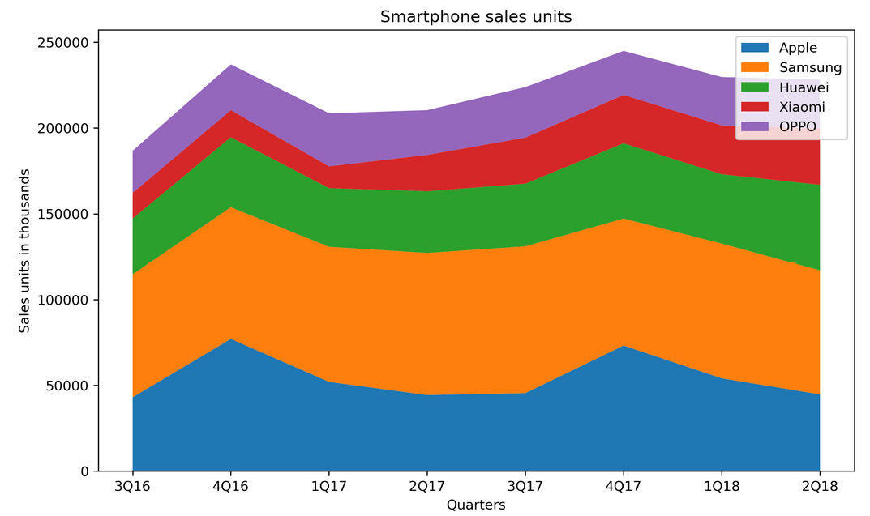
Creating a stacked area chart for smartphone sales unit - Output
Stacked area chart comparing sales units of different smartphone manufacturers

Slide 94
Histogram

Slide 95
Using histogram to visualize IQ
We will visualize the intelligence quotient (IQ) using histogram. 100 people have come for an interview in a company. To place an individual applicant in the overall group, a histogram shall be used.
Note:
The plt.axvline(x, [color=…], [linestyle=…]) function draws a vertical line at position x.

Slide 96
Histogram
A histogram visualizes the distribution of a single numerical variable. Each bar represents the frequency for a certain interval. The plt.hist(x) function creates a histogram
Important Parameters:
x: Specifies the input values.
bins: (optional): Specifies the number of bins as an integer or specifies the bin edges as a list.
range: (optional): Specifies the lower and upper range of the bins as a tuple.
density: (optional): If true, the histogram represents a probability density.

Slide 97
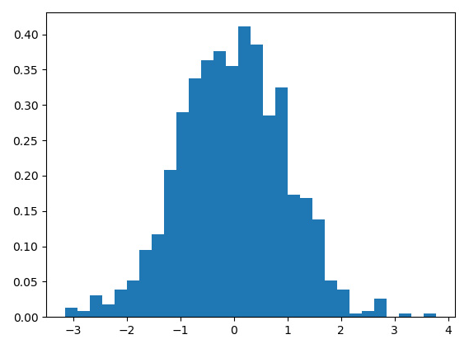
Histogram - Example
plt.hist(x, bins=30, density=True)
Histogram

Slide 98
Using histogram to visualize IQ
The following are the steps to perform:
Import the necessary modules and enable plotting within a Jupyter Notebook
Use pandas to read the IQ.csv dataset
Plot a histogram with 10 bins for the given IQ scores. IQ scores are normally distributed with a mean of 100 and a standard deviation of 15. Visualize the mean as a vertical solid red line, and the standard deviation using dashed vertical lines. Add labels and a title.

Slide 99
Using histogram to visualize IQ - Code
# Create figure
plt.figure(figsize=(6, 4), dpi=150)
# Create histogram
plt.hist(iq_scores, bins=10)
plt.axvline(x=100, color='r')
plt.axvline(x=115, color='r', linestyle= '--')
plt.axvline(x=85, color='r', linestyle= '--')
# Add labels and title
plt.xlabel('IQ score')
plt.ylabel('Frequency')
plt.title('IQ scores for a test group of a hundred adults')
# Show plot
plt.show()

Slide 100
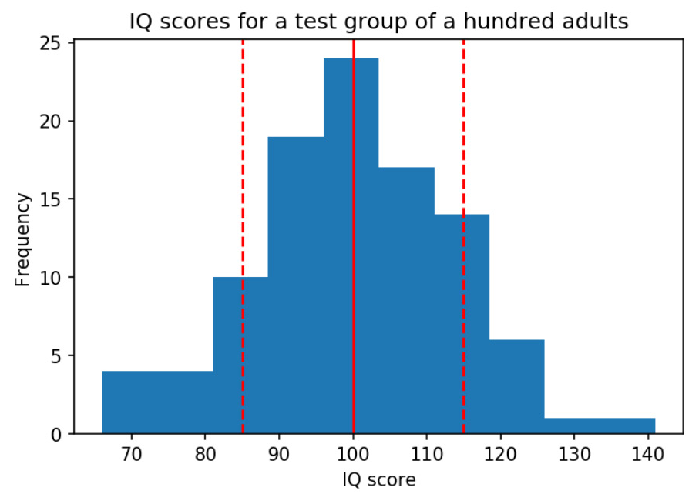
Using histogram to visualize IQ - Output
Histogram for an IQ test

Slide 101
Box Plot

Slide 102
Box Plot
The box plot shows multiple statistical measurements. The box extends from the lower to the upper quartile values of the data, thereby allowing us to visualize the interquartile range. For more details regarding the plot, refer to the previous chapter. The plt.boxplot(x) function creates a box plot.

Slide 103
Box Plot
Important Parameters:
x: Specifies the input data. It specifies either a 1D array for a single box, or a sequence of arrays for multiple boxes.
notch: (optional) If true, notches will be added to the plot to indicate the confidence interval around the median.
labels: (optional) Specifies the labels as a sequence.
showfliers: (optional) By default, it is true, and outliers are plotted beyond the caps.
showmeans: (optional) If true, arithmetic means are shown.

Slide 104
Box plot - Example - Code
## numpy is used for creating fake data
import numpy as np
import matplotlib as mpl
import matplotlib.pyplot as plt
## Create data
np.random.seed(10)
collectn_1 = np.random.normal(100, 10, 200)
collectn_2 = np.random.normal(80, 30, 200)
collectn_3 = np.random.normal(90, 20, 200)
collectn_4 = np.random.normal(70, 25, 200)
## combine these different collections into a list
data_to_plot = [collectn_1, collectn_2, collectn_3, collectn_4]

Slide 105
Box plot - Example - Code (Contd…)
# Create a figure instance
fig = plt.figure(1, figsize=(9, 6))
# Create an axes instance
ax = fig.add_subplot(111)
# Create the boxplot
bp = ax.boxplot(data_to_plot)
# Save the figure
fig.savefig('fig1.png', bbox_inches='tight')

Slide 106
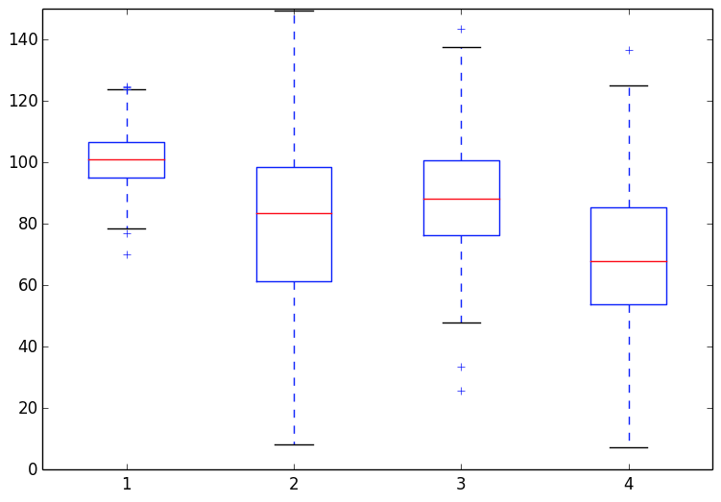
Box plot - Example - Output
Box plot

Slide 107
Using boxplot to visualize IQ
We will visualize the intelligence quotient (IQ) using boxplot. 100 people have come for an interview in a company. To place an individual applicant in the overall group, a box plot shall be used.

Slide 108
Using boxplot to visualize IQ
The following are the steps to perform:
Import the necessary modules and enable plotting within a Jupyter Notebook
Use pandas to read the IQ.csv dataset
Create a box plot to visualize the IQ scores. Add labels and a title

Slide 109
Using boxplot to visualize IQ - Code
Create a box plot to visualize the same IQ scores. Add labels and a title.
# Create figure
plt.figure(figsize=(6, 4), dpi=150)
# Create histogram
plt.boxplot(iq_scores)
# Add labels and title
ax = plt.gca()
ax.set_xticklabels(['Test group'])
plt.ylabel('IQ score')
plt.title('IQ scores for a test group of a hundred adults')
# Show plot
plt.show()

Slide 110
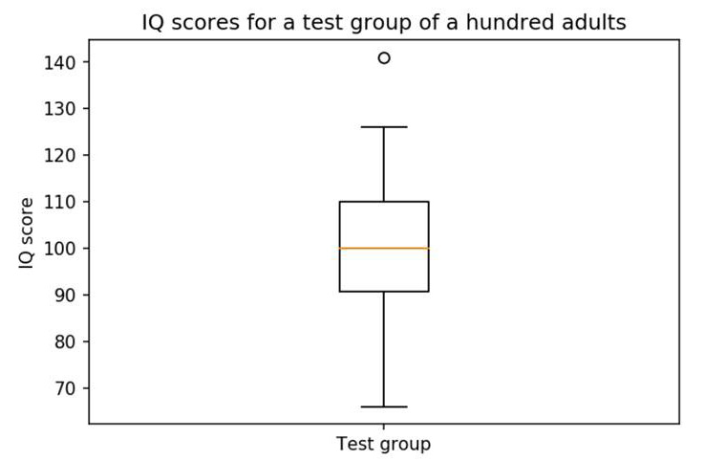
Using boxplot to visualize IQ - Output
Boxplot for IQ Scores

Slide 111
Scatter Plot

Slide 112
Scatter plot
Scatter plots show data points for two numerical variables, displaying a variable on both axes. plt.scatter(x, y) creates a scatter plot of y versus x, with optionally varying marker size and/or color.
Important Parameters:
x, y: Specifies the data positions.
s: (optional) Specifies the marker size in points squared.
c: (optional) Specifies the marker color. If a sequence of numbers is specified, the numbers will be mapped to the colors of the color map.

Slide 113
Scatter plot - Example - Code
import matplotlib.pyplot as plt
girls_grades = [89, 90, 70, 89, 100, 80, 90, 100, 80, 34]
boys_grades = [30, 29, 49, 48, 100, 48, 38, 45, 20, 30]
grades_range = [10, 20, 30, 40, 50, 60, 70, 80, 90, 100]
fig=plt.figure()
ax=fig.add_axes([0,0,1,1])
ax.scatter(grades_range, girls_grades, color='r')
ax.scatter(grades_range, boys_grades, color='b')
ax.set_xlabel('Grades Range')
ax.set_ylabel('Grades Scored')
ax.set_title('scatter plot')
plt.show()

Slide 114
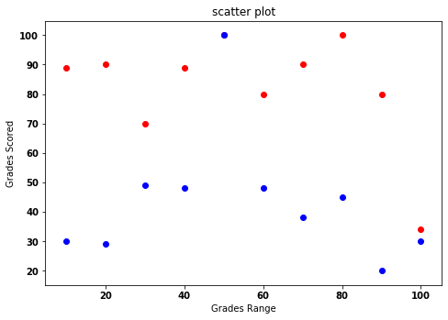
Scatter plot - Example - Code - Output
Scatter plot

Slide 115
Using scatter plot to visualize correlation between various animals
We will use a scatter plot to show correlation within a dataset. Let's look at the following scenario: You are given a dataset containing information about various animals. Visualize the correlation between the various animal attributes
Note:
The Axes.set_xscale('log') and the Axes.set_yscale('log') change the scale of the x-axis and y-axis to a logarithmic scale, respectively.

Slide 116
Using scatter plot to visualize correlation between various animals
The following are the steps to perform:
Import the necessary modules and enable plotting within a Jupyter Notebook.
Use pandas to read the ‘anage_data.csv’
The given dataset is not complete. Filter the data so that you end up with samples containing a body mass and a maximum longevity. Sort the data according to the animal class; here, the isfinite() function (to check whether the number is finite or not) checks for the finiteness of the given element:

Slide 117
Using scatter plot to visualize correlation between various animals
Create a scatter plot visualizing the correlation between the body mass and the maximum longevity. Use different colors to group data samples according to their class. Add a legend, labels, and a title. Use a log scale for both the x-axis and y-axis:

Slide 118
Using scatter plot to visualize correlation between various animals - Code
# Create figure
plt.figure(figsize=(10, 6), dpi=300)
# Create scatter plot
plt.scatter(amphibia[mass], amphibia[longevity], label='Amphibia')
plt.scatter(aves[mass], aves[longevity], label='Aves')
plt.scatter(mammalia[mass], mammalia[longevity], label='Mammalia')
plt.scatter(reptilia[mass], reptilia[longevity], label='Reptilia')
# Add legend
plt.legend()
# Log scale
ax = plt.gca()
ax.set_xscale('log')
ax.set_yscale('log')
# Add labels
plt.xlabel('Body mass in grams')
plt.ylabel('Maximum longevity in years')
# Show plot
plt.show()

Slide 119
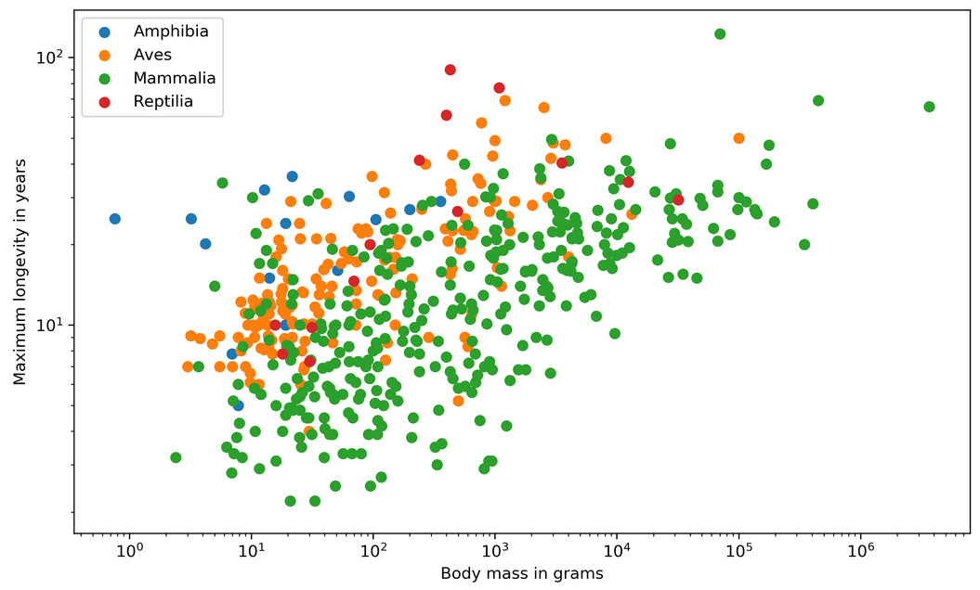
Using scatter plot to visualize correlation between various animals - Output
Scatter plot on animal statistics
From the preceding output, we can visualize the correlation between various animals based on the maximum longevity in years and body mass in grams

Slide 120
Sub Plots

Slide 121
Sub plot
It is often useful to display several plots next to one another. Matplotlib offers the concept of subplots, which are multiple Axes within a Figure. These plots can be grids of plots, nested plots, and so on.
Explore the following options to create subplots:
The plt.subplots(, ncols) function creates a Figure and a set of subplots. nrows, ncols define the number of rows and columns of the subplots, respectively.
The plt.subplot(nrows, ncols, index) function or, equivalently, plt.subplot(pos) adds a subplot to the current Figure. The index starts at 1. The plt.subplot(2, 2, 1) function is equivalent to plt.subplot(221).

Slide 122
Sub plot - Options
The Figure.subplots(nrows, ncols) function adds a set of subplots to the specified Figure.
The Figure.add_subplot(nrows, ncols, index) function or, equivalently, Figure.add_subplot(pos), adds a subplot to the specified Figure.

Slide 123
Sub plot - Note
Note:
To share the x-axis or y-axis, the parameters sharex and sharey must be set, respectively. The axis will have the same limits, ticks, and scale.
plt.subplot and Figure.add_subplot have the option to set a projection. For a polar projection, either set the projection='polar' parameter or the parameter polar=True parameter.

Slide 124
Creating a scatter plot with marginal histograms
We will make use of GridSpec to visualize a scatter plot with marginal histograms. Let's look at the following scenario: you are given a dataset containing information about various animals. Visualize the correlation between the various animal attributes using scatter plots and marginal histograms.

Slide 125
Creating a scatter plot with marginal histograms
The following are the steps to perform:
Import the necessary modules and enable plotting within a Jupyter Notebook.
Filter the data so that you end up with samples containing a body mass and maximum longevity as the given dataset, AnAge, which was used in the previous exercise, is not complete. Select all of the samples of the Aves class with a body mass of less than 20,000.
Create a Figure with a constrained layout. Create a gridspec of size 4x4. Create a scatter plot of size 3x3 and marginal histograms of size 1x3 and 3x1. Add labels and a Figure title.

Slide 126
Creating a scatter plot with marginal histograms - Code
# Create figure
fig = plt.figure(figsize=(8, 8), dpi=150, constrained_layout=True)
# Create gridspec
gs = fig.add_gridspec(4, 4)
# Specify subplots
histx_ax = fig.add_subplot(gs[0, :-1])
histy_ax = fig.add_subplot(gs[1:, -1])
scatter_ax = fig.add_subplot(gs[1:, :-1])

Slide 127
Creating a scatter plot with marginal histograms - Code (contd...)
# Create plots
scatter_ax.scatter(aves[mass], aves[longevity])
histx_ax.hist(aves[mass], bins=20, density=True)
histx_ax.set_xticks([])
histy_ax.hist(aves[longevity], bins=20, density=True, orientation='horizontal')
histy_ax.set_yticks([])
# Add labels and title
plt.xlabel('Body mass in grams')
plt.ylabel('Maximum longevity in years')
fig.suptitle('Scatter plot with marginal histograms')
# Show plot
plt.show()

Slide 128
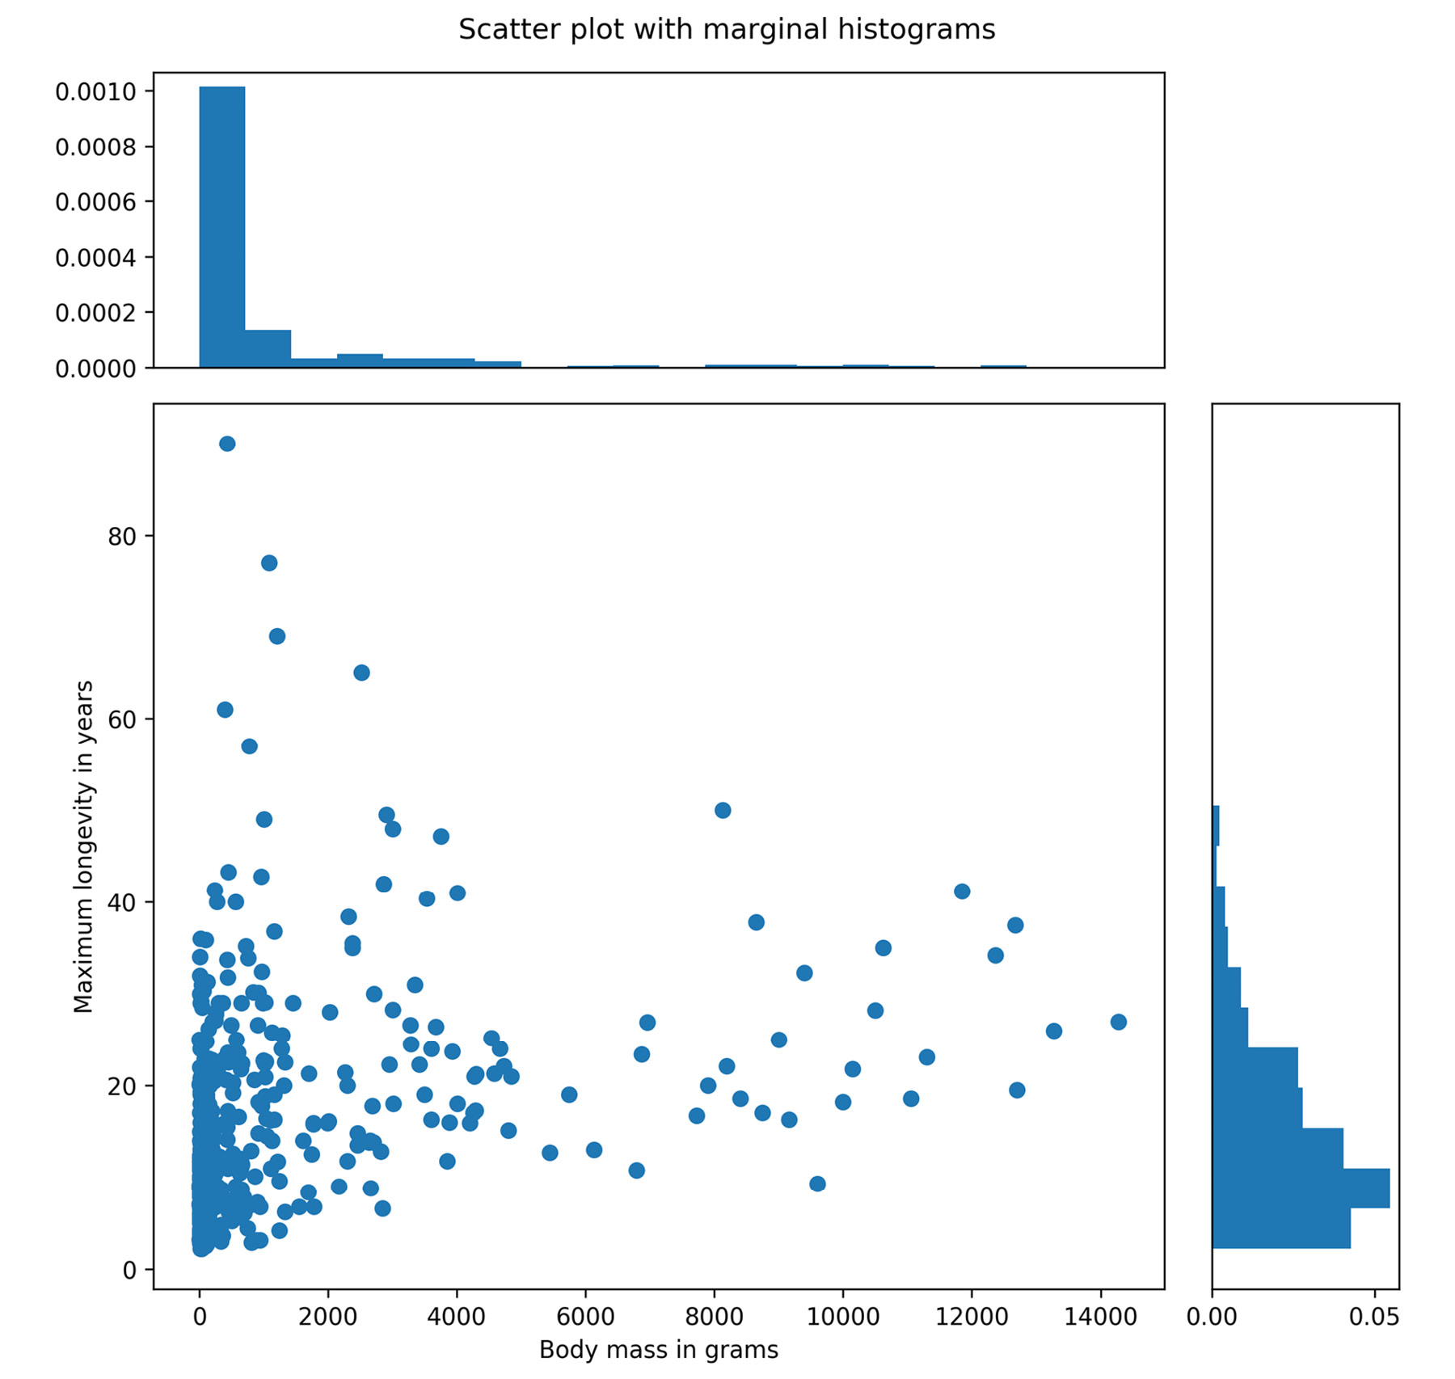
Creating a scatter plot with marginal histograms - output
Scatter plots with marginal histograms

Slide 129




THANK YOU
Presenter’s Name
Presenter’s Name
Contact Us
support@knowledgehut.com
Presenter’s Designation

